Slide 1
Multiple Linear Regression

Slide 2
Multiple Linear Regression (MLR)
Most common form of linear regression analysis
Relationship between one continuous dependent variable and two or more independent variables

Slide 3
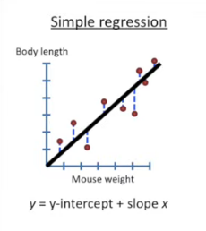
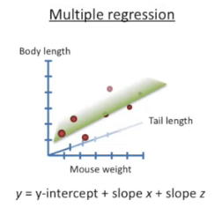
Calculating R² is same for both Simple and Multiple regression

Slide 4
Multiple Linear Regression (MLR)
Adding multiple independent variables to a MLR model will always increase the amount of explained variance in the dependent variable (typically expressed as R²)

Slide 5
Multiple Linear Regression (MLR)
Equation of MLR model
$$y=Ѳ_{0}+Ѳ1x_{1}+Ѳ_{2}x_{2}+…+Ѳ_{n}x_{n}$$

Slide 6
How Multiple Linear Regression (MLR) is useful ?
To identify the strength of the effect that the independent variables have on a dependent variable
To forecast effects or impacts of changes (GPA change w.r.t. IQ)
To guess the precise values / trends (price of gold after 6 months from now)

Slide 7
Significance of ‘Backword Elimination’ and ‘p-value’
P value informs about significance of your results
P value tells us how likely it is to get a result like this if the null hypothesis is true

Slide 8
Significance of p-value …
Note:
A null hypothesis is a type of hypothesis used in statistics that proposes that no statistical significance exists in a set of given observations. The null hypothesis attempts to show that no variation exists between variables or that a single variable is no different than its mean.

Slide 9
Significance of p-value …
The p-value is a number between 0 and 1
A low P value suggests that your sample provides enough evidence that you can reject the null hypothesis for the entire population.
The smaller the p-value, the higher the significance

Slide 10
For Multiple regression you adjust the R² to compensate for the additional parameter s in the equation

Slide 11
Algorithm for Multiple Linear Regression (MLR)
Import the libraries
Import the dataset
Encoding the categorical data
Splitting the dataset into the Training set and Test set

Slide 12
Algorithm for Multiple Linear Regression (MLR)…
Fitting Multiple Linear Regression to the Training set
Predicting the Test set results
Building the optimal model using backword elimination
End
Notes:
Backward elimination, which involves starting with all candidate variables, testing the deletion of each variable using a chosen model fit criterion, deleting the variable (if any) whose loss gives the most statistically insignificant deterioration of the model fit, and repeating this process until no further variables can be deleted without a statistically significant loss of fit.

